Slide 1
Orphan Drugs
FDA approves first AI drug for rare disease

Slide 2
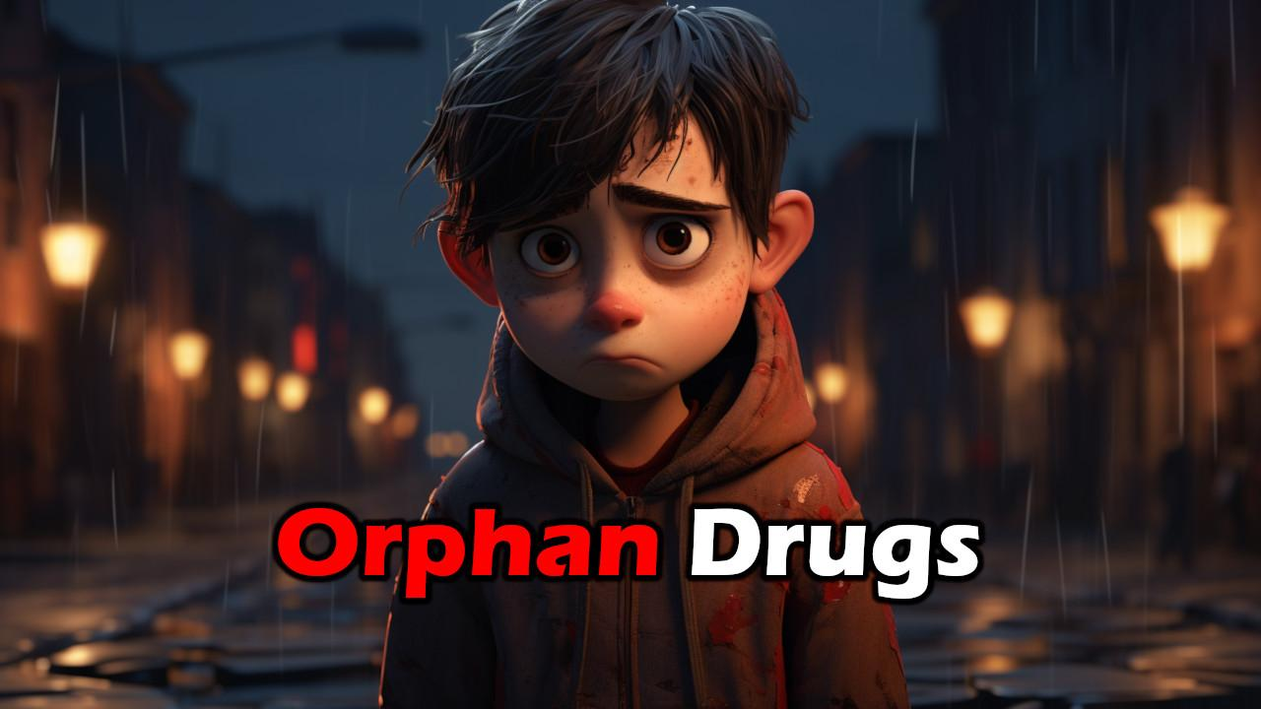

Slide 3
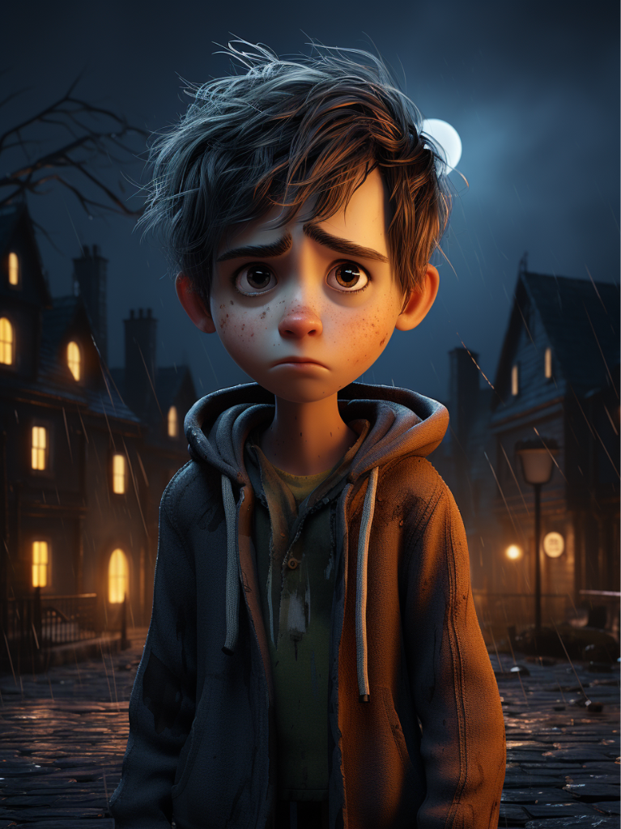
What is an Orphan Drug?
Orphan Drug Status is a designation given by the U.S. Food and Drug Administration (FDA) to drugs and biologics intended to treat rare diseases or conditions. A rare disease, according to FDA guidelines, affects fewer than 200,000 people in the United States.
Incentives: Companies that develop orphan drugs are eligible for various incentives, including tax credits for clinical research, reduced filing fees, and potential for seven years of market exclusivity upon approval.
Development Grants: FDA may offer grants for clinical trials and research specifically aimed at developing orphan drugs.
Accelerated Review: The approval process for orphan drugs can be faster than that for other drug categories, although it still needs to meet the FDA’s safety and efficacy standards.
Protocol Assistance: The FDA can provide scientific advice and guidance to help companies navigate the development and approval process for an orphan drug.
Orphan Drug Act: Established in 1983, this U.S. law aimed to encourage the development of drugs for rare diseases by providing these benefits and incentives.

Slide 4
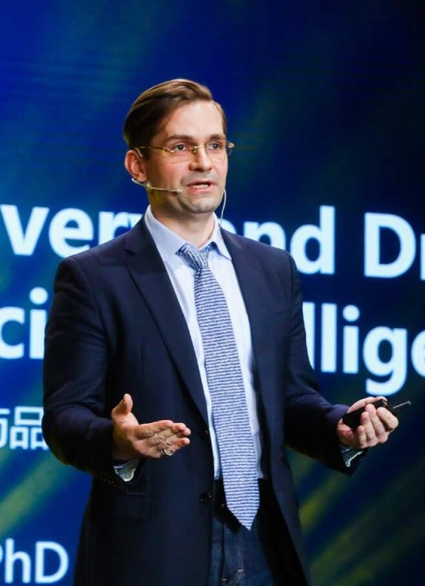
First AI Orphan Drug
Insilico Medicine
INS018_055 is a small molecule targeted at idiopathic pulmonary fibrosis (IPF)
Disease has no apparent cause and no cure
Prognosis: median survival is 2 to 5 years
Primarily affects adults aged 50 to 70
Drug candidate target selected by AI
Details about their process are somewhat closed
Was generated by their in-house Pharma.AI platform
Will be entering Phase II clinical trials
“discovered and designed using artificial intelligence”
Pictured at right:
Alex Zhavoronkov, PhD
CEO of Insilico Medicine

Slide 5

So what?
Proof of Concept: This opens the door to more investment and trust in AI drug discovery.
De-risking investment means more VC
Where the money goes, so too goes research and results
Serving Everyone: Drug discovery is ludicrously expensive, hence why “orphan drug” laws exist.
Anyone with rare diseases knows how hopeless it feels
There are 17,000 unique codes in ICD-11
Another 120,000 total possible permutations
Practical vs Theoretical: The benefits of AI and drug discovery is no longer pure theory, now it is real.
For instance, “New study uses AlphaFold and AI to accelerate design of novel drug for liver cancer” earlier this year
It’s one thing to hypothetically design a drug in a lab
It’s entirely another to get it to the FDA and clinical trials

Slide 6

Takeaways
More Diseases Treated: As long as this pans out (or another one does) we should expect to see an uptick in AI-discovered and designed drugs.
More Research, More Funding: Businesses are always seeking new revenue streams, getting 7 year exclusivity on an Orphan Drug is a pretty big incentive.
Possible Gold Rush: If AI can drastically reduce the time and cost associated with discovering orphan drugs, we might see a huge surge due to latent, unmet demand.
Not financial or investment advice
I personally avoid speculative penny stocks like the plague
Cheaper Medicine: This is a long shot, but I hope that AI driving the price of drug discovery down means that medicine will soon become much, much cheaper (including rejuvenation and regeneration)

Slide 7
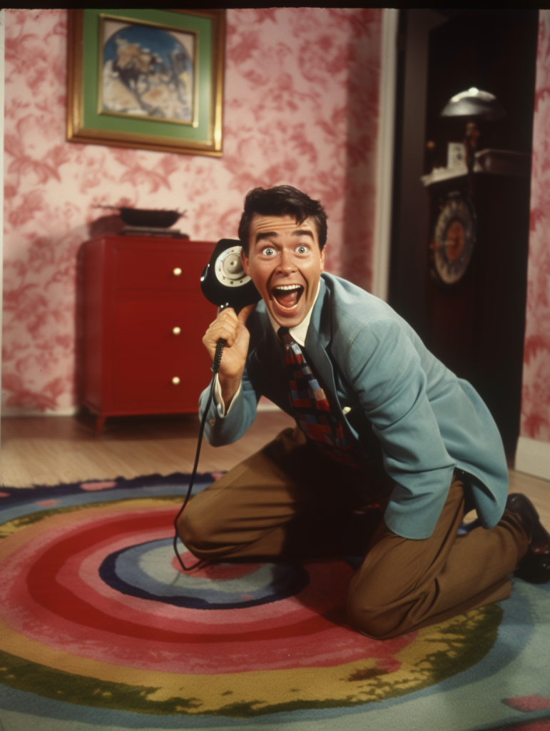
Call to Action
Support Open Source: Lots of companies benefit from open source tools, research, and coding examples
Spread the Word: This is really great news. Tell people about it, build consensus around AI and medicine
Help Me Out: Support me on Patreon, like and subscribe, comment and share
Vote Accordingly: Pay attention to politicians anywhere who understand the importance of balance and nuance where AI is concerned
It’s about balancing public good versus private interest
Look out for regulatory capture, monopolization

Slide 8
Thank you

